Slide 1
Introduction
What are embedded systems?
Challenges in embedded computing system design.
Design methodologies.

Slide 2
Definition
Embedded system: any device that includes a programmable computer but is not itself a general-purpose computer.
Take advantage of application characteristics to optimize the design:
  don’t need all the general-purpose bells and whistles.

Slide 3
Embedding a computer
output
analog
CPU
input
analog
mem
embedded
computer

Slide 4
Examples
Personal digital assistant (PDA).
Printer.
Cell phone.
Automobile: engine, brakes, dash, etc.
Television.
Household appliances.
PC keyboard (scans keys).

Slide 5
Early history
Late 1940’s: MIT Whirlwind computer was designed for real-time operations.
  Originally designed to control an aircraft simulator.
First microprocessor was Intel 4004 in early 1970’s.
HP-35 calculator used several chips to implement a microprocessor in 1972.

Slide 6
Early history, cont’d.
Automobiles used microprocessor-based engine controllers starting in 1970’s.
  Control fuel/air mixture, engine timing, etc.
  Multiple modes of operation: warm-up, cruise, hill climbing, etc.
  Provides lower emissions, better fuel efficiency.

Slide 7
Microprocessor varieties
Microcontroller: includes I/O devices, on-board memory.
Digital signal processor (DSP): microprocessor optimized for digital signal processing.
Typical embedded word sizes: 8-bit, 16-bit, 32-bit.

Slide 8
Application examples
Simple control: front panel of microwave oven, etc.
Canon EOS 3 has three microprocessors.
  32-bit RISC CPU runs autofocus and eye control systems.
Analog TV: channel selection, etc.
Digital TV: programmable CPUs + hardwired logic.

Slide 9
Automotive embedded systems
Today’s high-end automobile may have 100 microprocessors:
  4-bit microcontroller checks seat belt;
  microcontrollers run dashboard devices;
  16/32-bit microprocessor controls engine.

Slide 10
BMW 850i brake and stability control system
Anti-lock brake system (ABS): pumps brakes to reduce skidding.
Automatic stability control (ASC+T): controls engine to improve stability.
ABS and ASC+T communicate.
  ABS was introduced first---needed to interface to existing ABS module.

Slide 11
BMW 850i, cont’d.
sensor
sensor
brake
brake
ABS
hydraulic
pump
brake
brake
sensor
sensor

Slide 12
Characteristics of embedded systems
Sophisticated functionality.
Real-time operation.
Low manufacturing cost.
Low power.
Designed to tight deadlines by small teams.

Slide 13
Functional complexity
Often have to run sophisticated algorithms or multiple algorithms.
  Cell phone, laser printer.
Often provide sophisticated user interfaces.

Slide 14
Real-time operation
Must finish operations by deadlines.
  Hard real time: missing deadline causes failure.
  Soft real time: missing deadline results in degraded performance.
Many systems are multi-rate: must handle operations at widely varying rates.

Slide 15
Non-functional requirements
Many embedded systems are mass-market items that must have low manufacturing costs.
  Limited memory, microprocessor power, etc.
Power consumption is critical in battery-powered devices.
  Excessive power consumption increases system cost even in wall-powered devices.

Slide 16
Design teams
Often designed by a small team of designers.
Often must meet tight deadlines.
  6 month market window is common.
  Can’t miss back-to-school window for calculator.

Slide 17
Why use microprocessors?
Alternatives: field-programmable gate arrays (FPGAs), custom logic, etc.
Microprocessors are often very efficient: can use same logic to perform many different functions.
Microprocessors simplify the design of families of products.

Slide 18
The performance paradox
Microprocessors use much more logic to implement a function than does custom logic.
But microprocessors are often at least as fast:
  heavily pipelined;
  large design teams;
  aggressive VLSI technology.

Slide 19
Power
Custom logic is a clear winner for low power devices.
Modern microprocessors offer features to help control power consumption.
Software design techniques can help reduce power consumption.

Slide 20
Challenges in embedded system design
How much hardware do we need?
  How big is the CPU? Memory?
How do we meet our deadlines?
  Faster hardware or cleverer software?
How do we minimize power?
  Turn off unnecessary logic? Reduce memory accesses?

Slide 21
Challenges, etc.
Does it really work?
  Is the specification correct?
  Does the implementation meet the spec?
  How do we test for real-time characteristics?
  How do we test on real data?
How do we work on the system?
  Observability, controllability?
  What is our development platform?

Slide 22
Design methodologies
A procedure for designing a system.
Understanding your methodology helps you ensure you didn’t skip anything.
Compilers, software engineering tools, computer-aided design (CAD) tools, etc., can be used to:
  help automate methodology steps;
  keep track of the methodology itself.

Slide 23
Design goals
Performance.
  Overall speed, deadlines.
Functionality and user interface.
Manufacturing cost.
Power consumption.
Other requirements (physical size, etc.)

Slide 24
Levels of abstraction
requirements
specification
architecture
component
design
system
integration

Slide 25
Top-down vs. bottom-up
Top-down design:
  start from most abstract description;
  work to most detailed.
Bottom-up design:
  work from small components to big system.
Real design uses both techniques.

Slide 26
Stepwise refinement
At each level of abstraction, we must:
  analyze the design to determine characteristics of the current state of the design;
  refine the design to add detail.

Slide 27
Requirements
Plain language description of what the user wants and expects to get.
May be developed in several ways:
  talking directly to customers;
  talking to marketing representatives;
  providing prototypes to users for comment.

Slide 28
Functional vs. non-functional requirements
Functional requirements:
  output as a function of input.
Non-functional requirements:
  time required to compute output;
  size, weight, etc.;
  power consumption;
  reliability;
  etc.

Slide 29
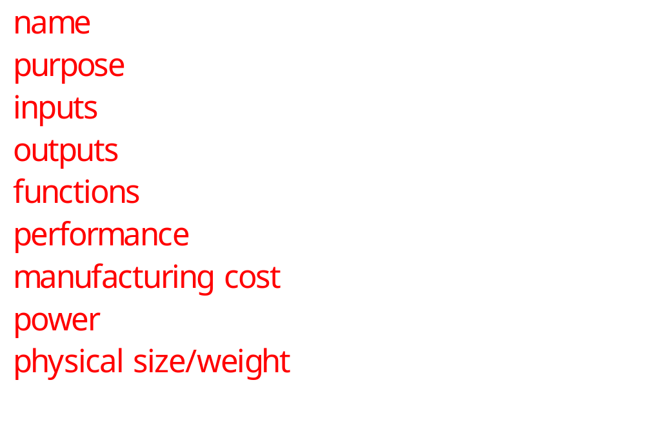
Our requirements form

Slide 30
Example: GPS moving map requirements
Moving map obtains position from GPS, paints map from local database.
I-78
Scotch Road
lat: 40 13 lon: 32 19

Slide 31
GPS moving map needs
Functionality: For automotive use. Show major roads and landmarks.
User interface: At least 400 x 600 pixel screen. Three buttons max. Pop-up menu.
Performance: Map should scroll smoothly. No more than 1 sec power-up. Lock onto GPS within 15 seconds.
Cost: $500 street price = approx. $100 cost of goods sold.

Slide 32
GPS moving map needs, cont’d.
Physical size/weight: Should fit in hand.
Power consumption: Should run for 8 hours on four AA batteries.

Slide 33
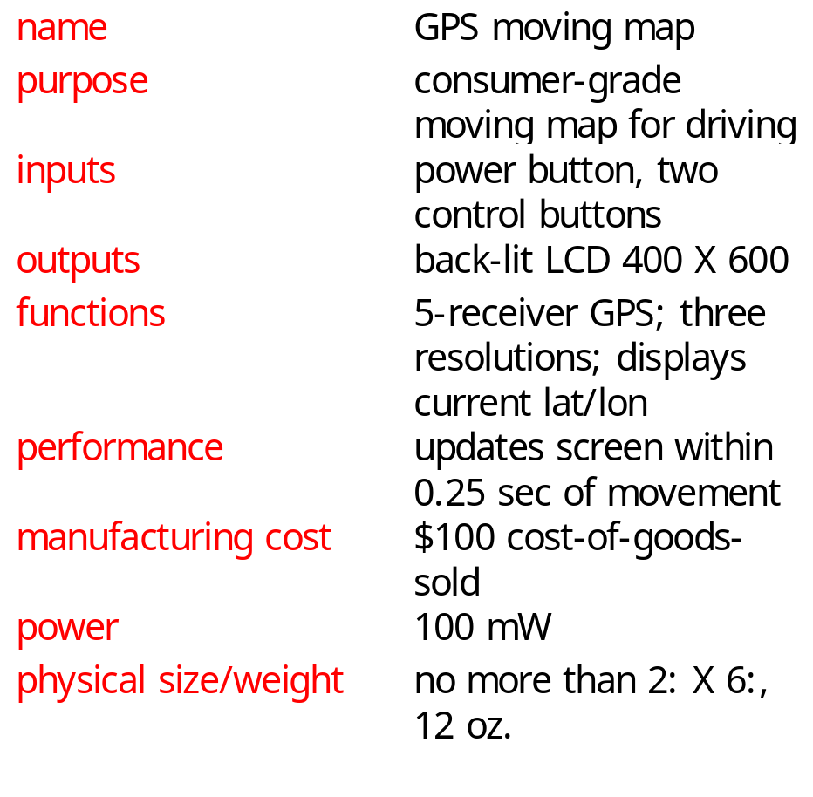
GPS moving map requirements form

Slide 34
Specification
A more precise description of the system:
  should not imply a particular architecture;
  provides input to the architecture design process.
May include functional and non-functional elements.
May be executable or may be in mathematical form for proofs.

Slide 35
GPS specification
Should include:
  What is received from GPS;
  map data;
  user interface;
  operations required to satisfy user requests;
  background operations needed to keep the system running.

Slide 36
Architecture design
What major components go satisfying the specification?
Hardware components:
  CPUs, peripherals, etc.
Software components:
  major programs and their operations.
Must take into account functional and non-functional specifications.

Slide 37
GPS moving map block diagram
GPS
receiver
search
engine
renderer
display
database
user
interface

Slide 38
GPS moving map hardware architecture
display
frame
buffer
CPU
GPS
receiver
memory
panel I/O

Slide 39
GPS moving map software architecture
position
database
search
renderer
pixels
user
interface
timer

Slide 40
Designing hardware and software components
Must spend time architecting the system before you start coding.
Some components are ready-made, some can be modified from existing designs, others must be designed from scratch.

Slide 41
System integration
Put together the components.
  Many bugs appear only at this stage.
Have a plan for integrating components to uncover bugs quickly, test as much functionality as early as possible.

Slide 42
Summary
Embedded computers are all around us.
  Many systems have complex embedded hardware and software.
Embedded systems pose many design challenges: design time, deadlines, power, etc.
Design methodologies help us manage the design process.

